Slide 1



BY ERIC ANDERSON
Roboto
A TYPEFACE FOR ALL

Slide 2

ABOUT ROBOTO
Roboto is a neo-grotesque sans-serif font released in 2011 by Christian Robertson.
It is a geometric font with a "friendly" perception — featuring open curves and natural widths.
Roboto is best used as a headline font, and pairs best (in my opinion) with Open Sans, Lato, and Montserrat.
ROBOTO

Slide 3
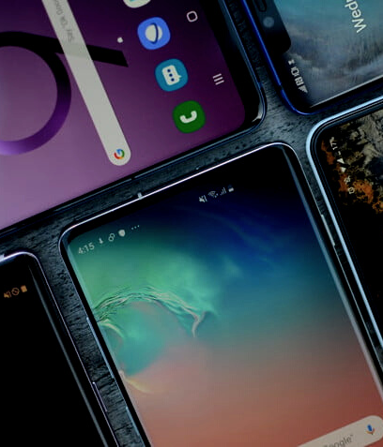

TECH INDUSTRY & TECH FORWARD COMPANIES
Roboto: Who, How, and Real World Examples of Usage
Android (Introduced in 4.0 "Ice Cream Sandwich")
Google Services (YouTube, Maps, Plus, etc.)
Dell website
European versions of Nintendo Switch
MTA SUBWAY
Clocks on B-Division lines (lettered lines)

Slide 4
WHY ROBOTO?
CLEAN & SIMPLE
LEDGIBLE
VERSATILE
Some grotesks distort letterforms to force rigid rhythm
Roboto uses natural widths for better readability
Can be used in a variety of cases
(web, clothing, print, etc.)
A great, free alternative to Helvetica
Mechanical skeleton & forms are largely geometric

Slide 5



Font Designers
CHRISTIAN ROBERTSON
ODED EZER
MEIR SADAN
Heebo (Hebrew Character Creator)
Heebo (Digital File Master/ Project Leader)
Roboto (Creator)

Slide 6
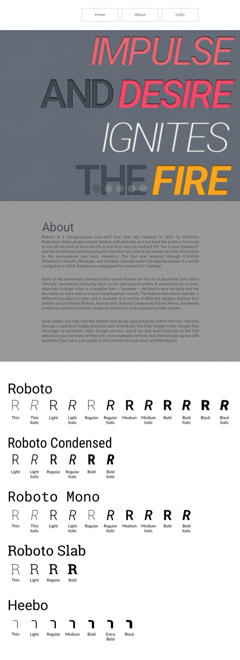

Home
SIMPLE DESIGN AND MODULAR COMPONENTS
Navigation
Header
Features 6 word memoir (which also utilizes Kerning
Kerning — adjusting spacing between each letter (different from tracking)
Text Section
Font Family Showcase

Slide 7
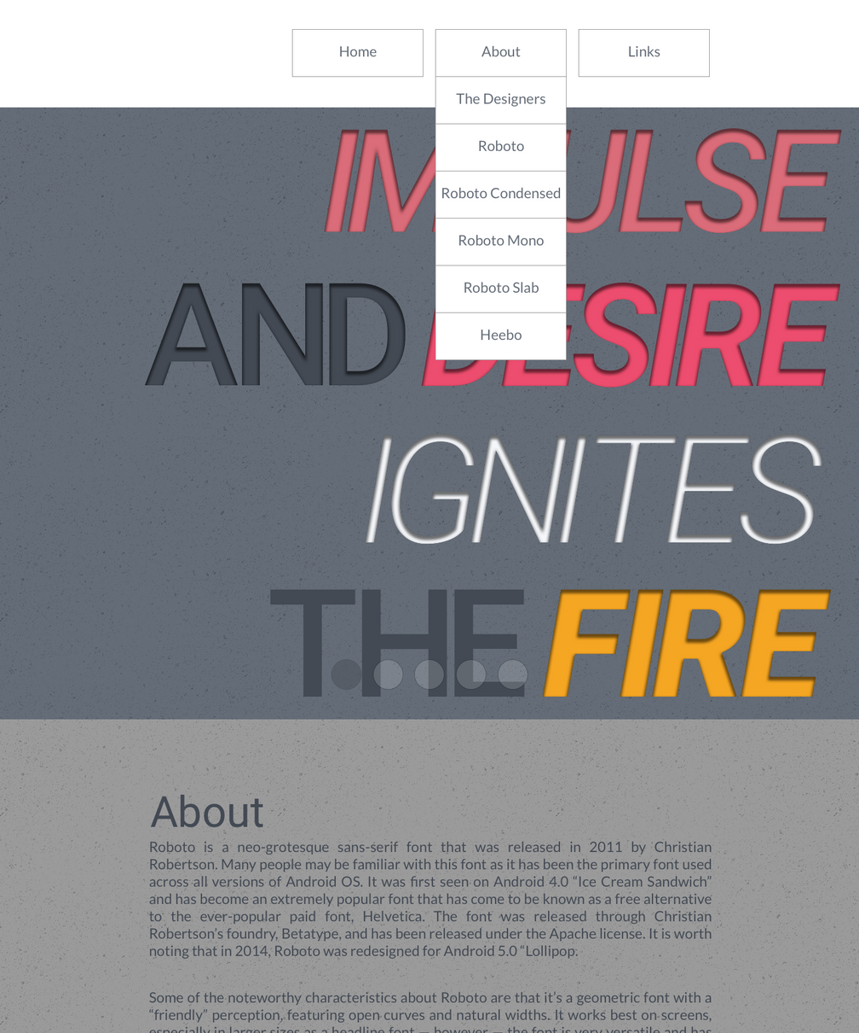
Home (With About Navigation Expanded)
K.I.S.S. — KEEP IT SIMPLE STUPID
Three navigation buttons
About the designers
About the different versions of the font

Slide 8
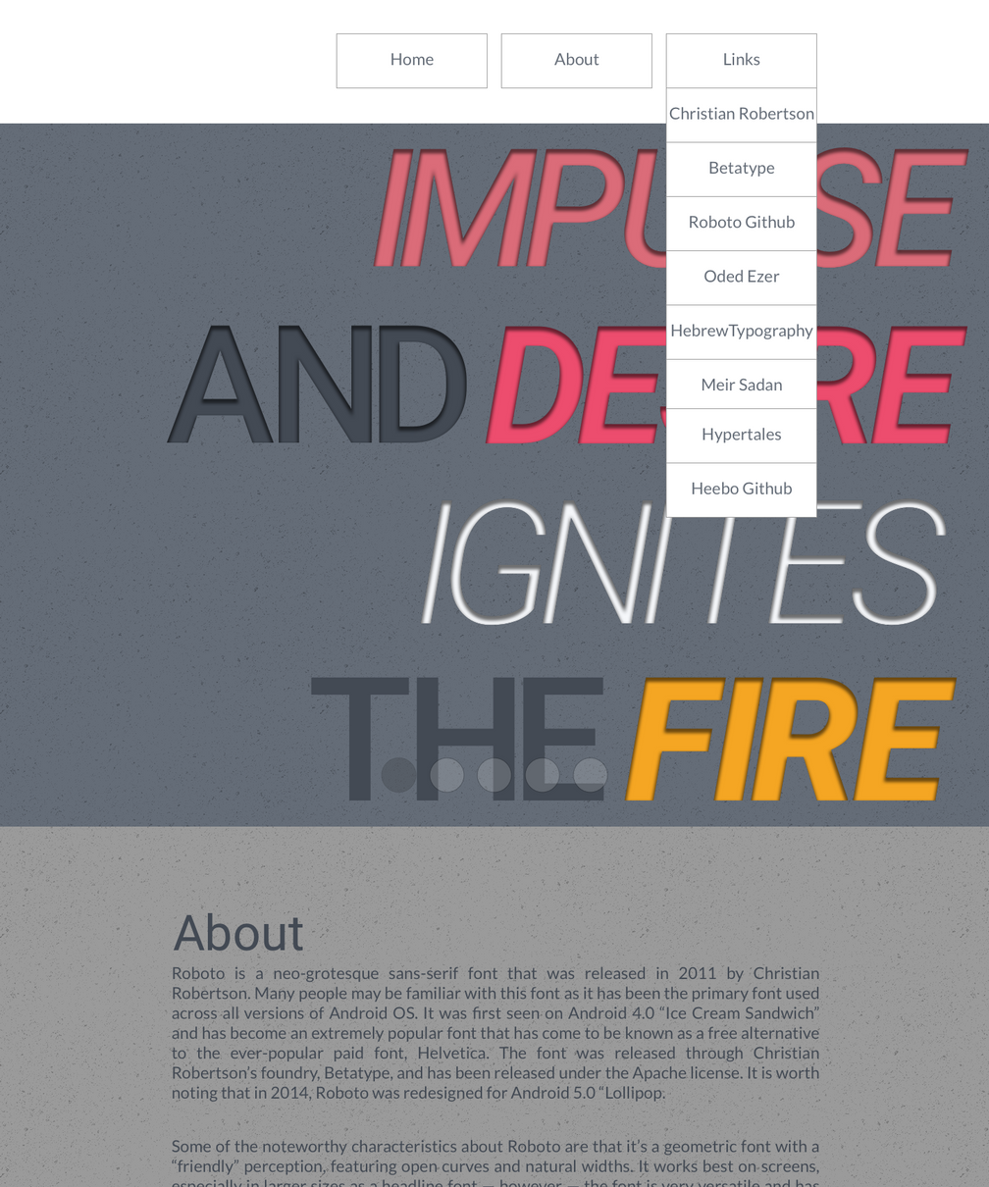
Home (With Links Navigation Expanded)
FOCUS, BUT STILL PROVIDE INFORMATION
Outward links to project authors' websites, foundries, and project GitHub pages
Allows focus to stay on showcasing the fonts while still offering more information if interested

Slide 9
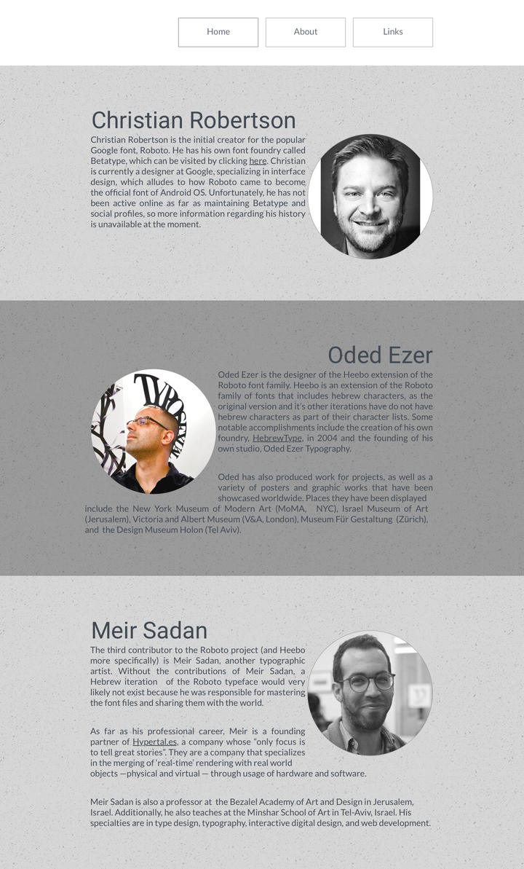
About (The Designers)
GIVING A FACE TO ROBOTO
"Containers" with information on each contributor and their respective project
Photos to enhance biographies

Slide 10
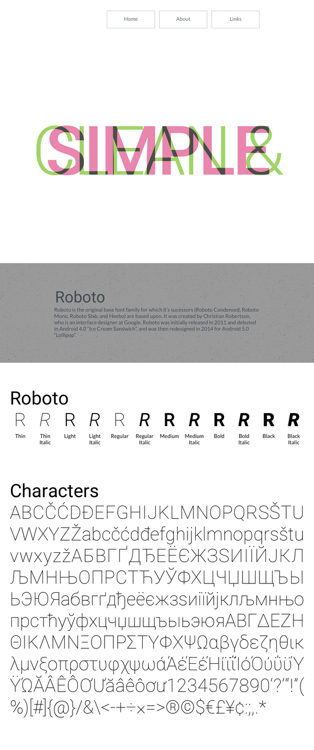
About (Roboto)
THE ORIGINAL
Neo-grotesque sans-serif font
Released in 2011
Created by Christian Robertson
12 different weights
First seen in Android OS 4.0 "Ice Cream Sandwich"
Redesigned for Android OS 5.0 "Lollipop" (2014)

Slide 11
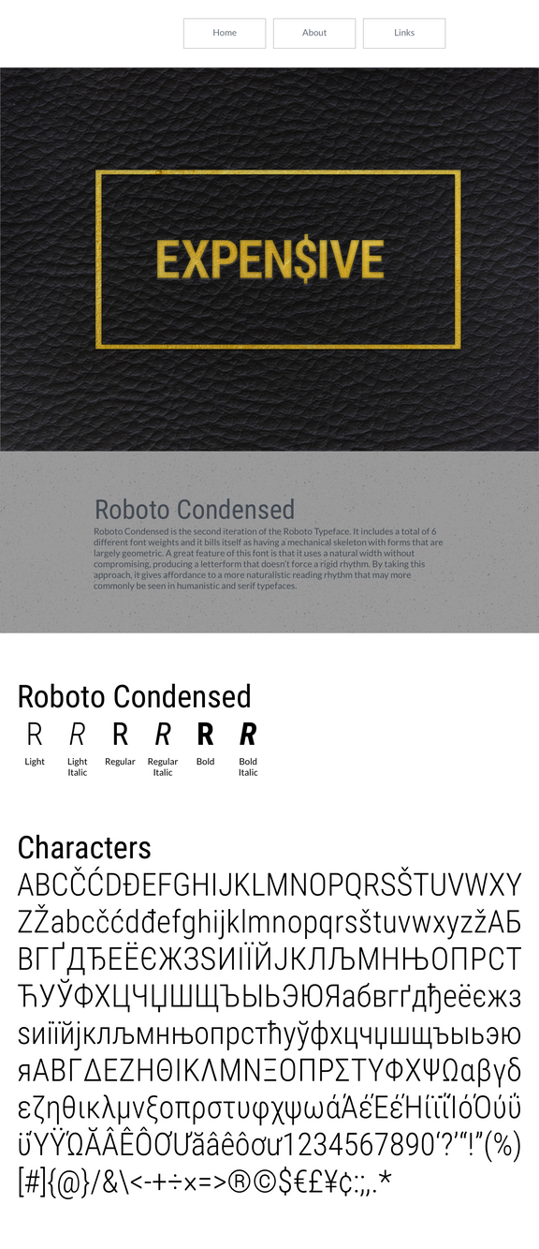
About (Roboto Condensed)
SLEEK AND SLIM
Second iteration of Roboto typeface
Shares many of the characteristics of Roboto with slimmer, narrower form factor
6 different weights

Slide 12
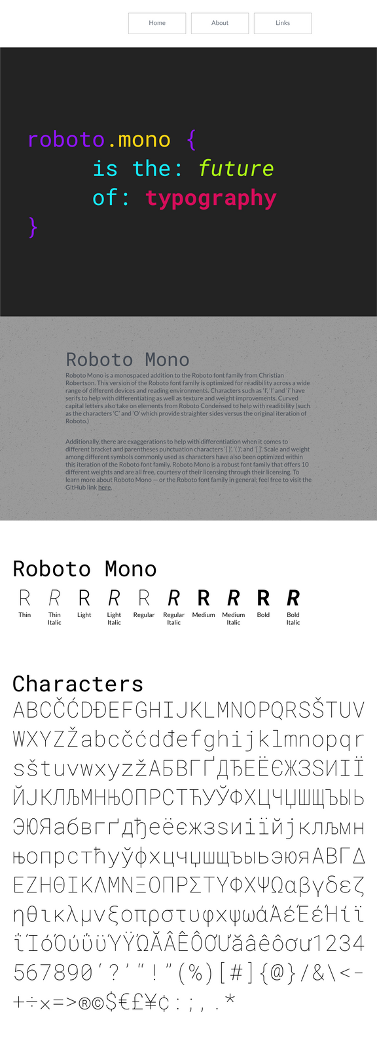
About (Roboto Mono)
SERIF, YOU SAY?
Optimized for readability through use of serifs
Texture and weight improvements
Curved capital letters from Roboto Condensed ('C' and 'O' offer straigher sides)
Exaggerations to differentiate parentheses/punctuation characters
10 different weights

Slide 13
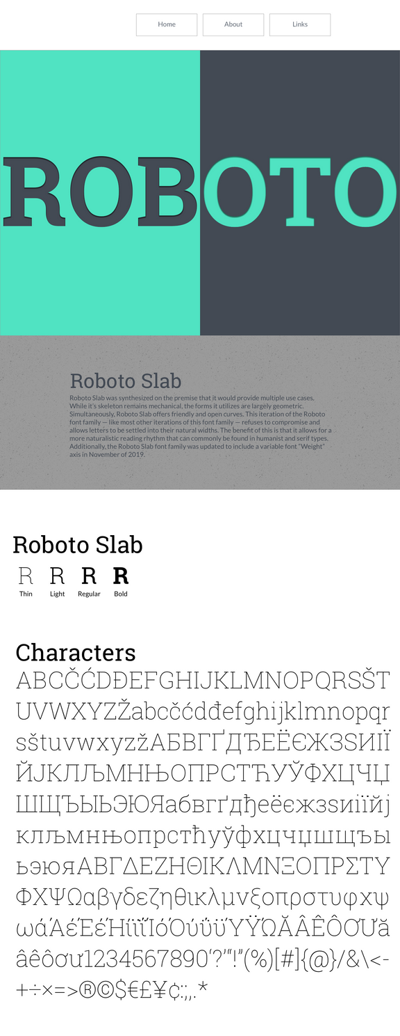
About (Roboto Slab)
YOU WANT MORE?
Utilizes serifs from Roboto Mono with additional serifs on certain letters ('A' is a great example)
Variable font weight axis (as of November 2019)
4 different weights

Slide 14
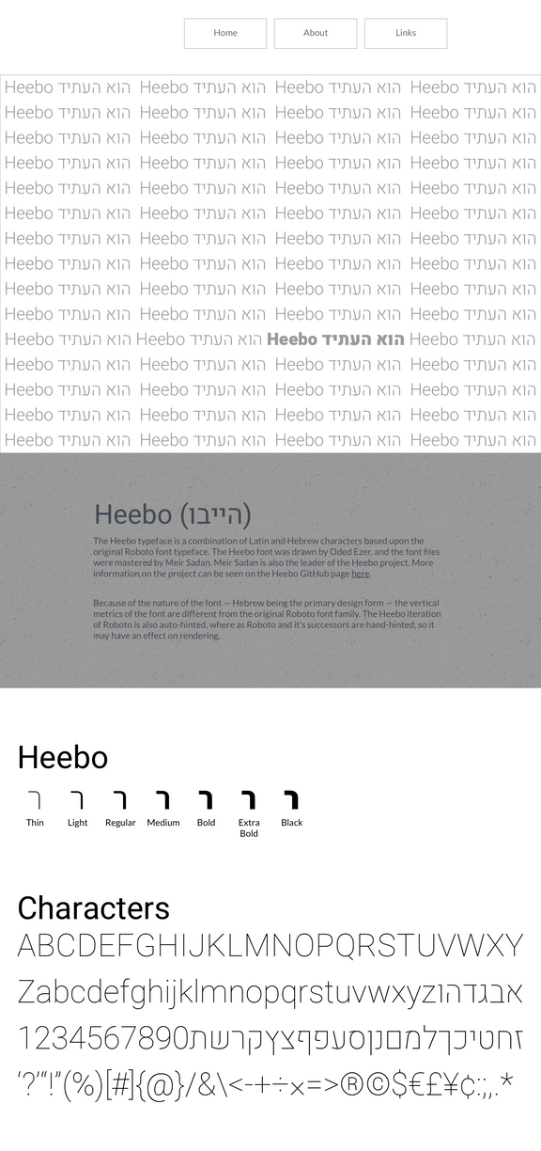
About (Heebo)
HEBREW? NO, HEEBO!
Based upon original Roboto typeface
Different vertical metrics
Auto-hinted font (Roboto is hand-hinted and may be better rendered on older machines)
7 different weights

Slide 15
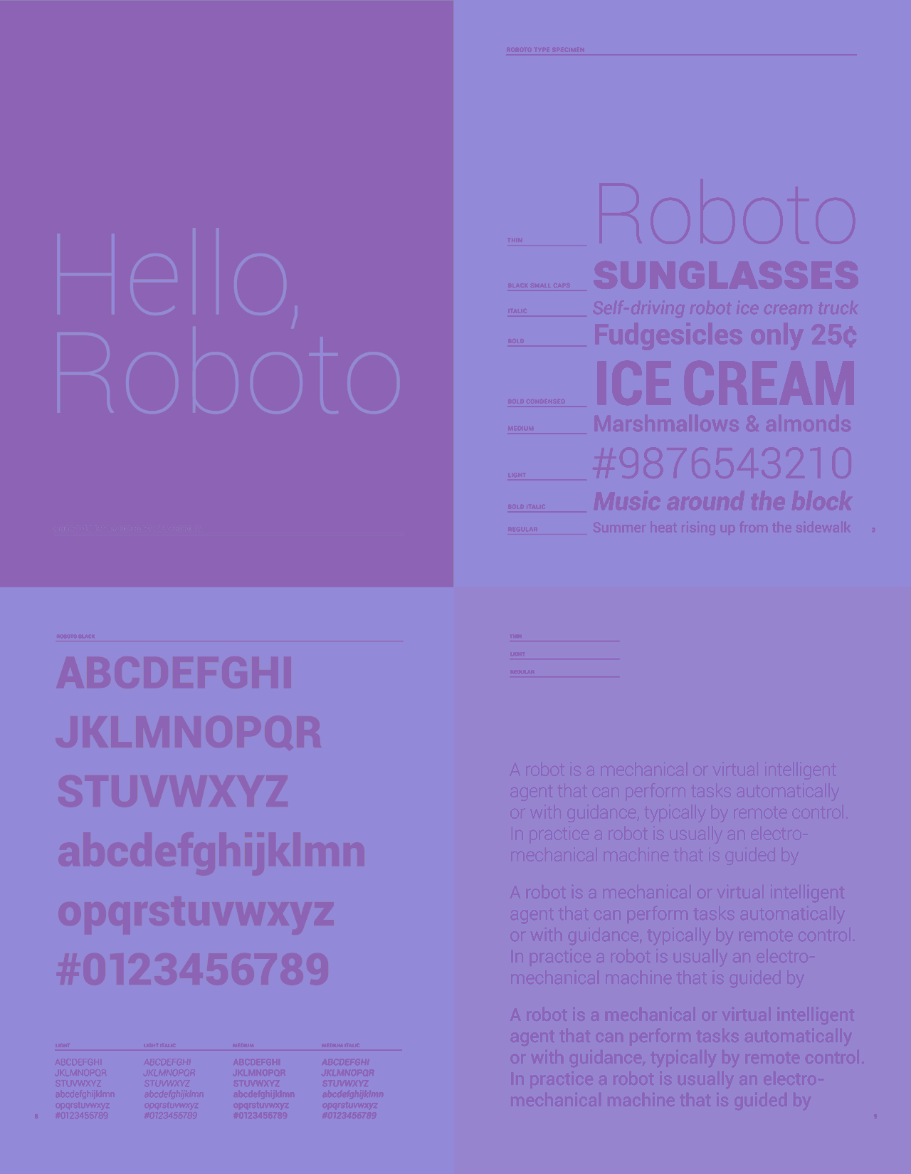


Any Questions?

